Slide 1
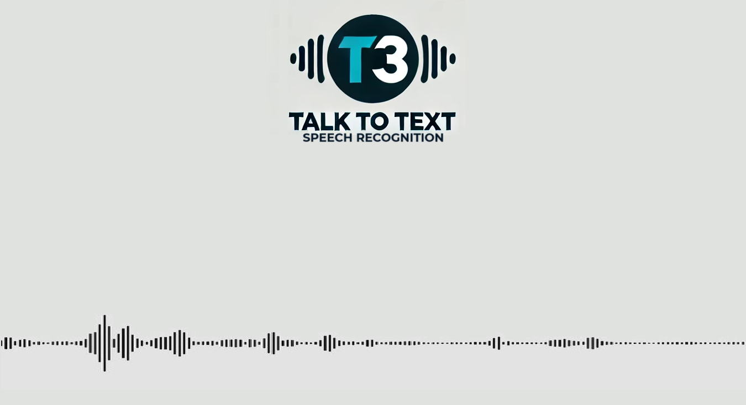
By
Essam Omar Mahmoud Amin
Mustafa Ashraf Salem Elsayed

Slide 2
Problem Statement
Manual transcription challenges: Time-consuming, tedious, and costly.
Inconsistent accuracy: Human transcription can be prone to errors, especially with complex audio.
Growing need for automation: More audio content demands faster and reliable transcription methods.
Diverse audio formats and quality: Handling varying sound qualities, accents, and noise levels.
Solution goal: Build an app to transcribe MP3 audio into accurate, full-text format efficiently.

Slide 3
Dataset
Dataset size: 3.3 GB
Structure: 25 audio files with corresponding text labels
Split:
Training set: 76% (19 audio-text pairs)
Evaluation set: 20% (5 audio-text pairs)
Test set: 4% (1 audio-text pair) “chosen due to resource limitations”
Reason for small test set: Limited computational resources and lengthy processing time
Data sources: Manually collected from AI podcasts and TED Talks on YouTube

Slide 4
Approach
Collecting Data: All team members collaborated to gather the dataset.
Loading, Cleaning, and Preprocessing the Dataset: Mahmoud Amin & Essam Omar
handled the initial data preparation.
Fine-tuning the Model: Essam Omar & Mahmoud Amin
worked together to fine-tune the Whisper-small model Using PEFT Technique with LoRA
(Low-Rank Adaptation) method for efficient parameter tuning.
Function for Predicting New Audio: Mahmoud Amin & Salem Elsayed
developed the function to predict transcriptions for new audio inputs.
Full Pipeline Function: Mustafa Ashraf & Essam Omar
built the complete pipeline for the speech-to-text process.
Model Deployment and Hosting: Mustafa Ashraf
managed the deployment and hosting of the final model.

Slide 5
Results
Evaluation Results of the Training:
Runtime: 17.53 min
Total Epochs: 10 Epoch
Training Loss: 2.893 (training loss of fine tunning whisper between [0,3])
Overall Word Error Rate (WER): 0.987%
Tested Audio Analysis (as one audio):
Total Words: 509
Average Substitutions: 77.5
Average Deletions: 6.0
Average Insertions: -4.5
Summary: The final transcription performance of the tested audio was calculated
over six 30-second audio chunks, providing the total word count and average values for
substitutions, deletions, and insertions.

Slide 6
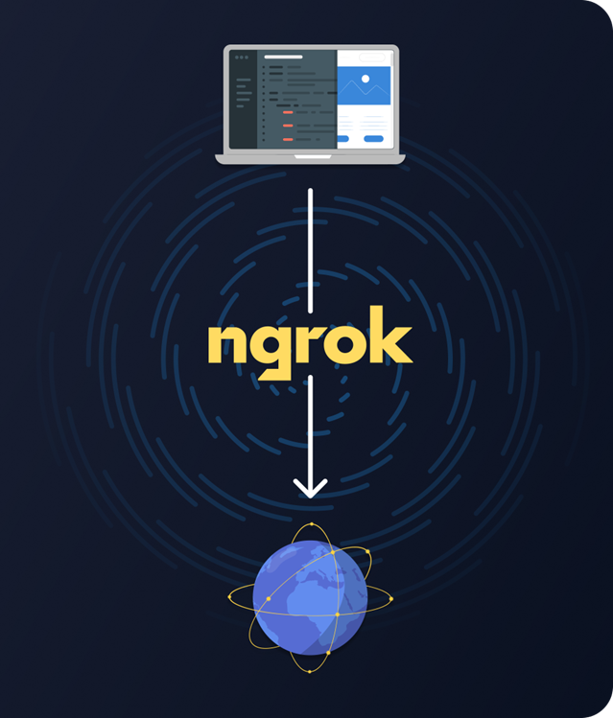


Deployment Methodology
Local Deployment:
The application is run locally (in the Google Colab environment).
Streamlit run the application on localhost (e.g., on port 8501).
Tunneling (using ngrok):
Since Colab operates in an environment that is not publicly accessible, ngrok is used to open a secure tunnel between Colab and the user.
A temporary public URL is provided, allowing the user to access the application running locally on Colab.

Slide 7
Demo
Notebook of the full model from loading data to Testing
Colab: T3_Fine_Tuned_org_dataset_V2
Deployment Notebook of only the fine tuned model with full pipeline function
Colab: T3_Production_V2
Model in Production Web App using Streamlit
Demo: https://132a-34-70-169-9.ngrok-free.app

